Slide 1

IniTech Solutions Asset Management
Archana Kanchimireddy (1232309145), Yasaswi Pandaraboyina (1231868705), Himaja Ghanashyam Dudhal (1232525413), Austin Rudolph (1221309089)
Austin Rudolph

Slide 2
Table of Contents
Title .​.​.​.​.​.​.​.​.​.​.​.​.​.​.​.​.​.​.​.​.​.​.​.​.​.​.​.​.​.​.​.​.​.​.​.​.​.​.​.​.​.​.​.​.​.​.​.​.​.​.​.​.​.​.​.​.​.​.​.​.​.​.​.​.​.​.​.​.​.​.​.​.​.​.​.​.​.​.​.​.​.​.​.​.​.​.​.​.​.​.​.​.​.​.​.​.​.​.​.​.​.​.​.​.​.​.​.​.​.​.​.​.​.​.​.​.​.​.​.​.​.​.​.​.​.​.​.​...​.​.​.​ 1
Table of Contents .​.​.​.​.​.​.​.​.​.​.​.​.​.​.​.​.​.​.​.​.​.​.​.​.​.​.​.​.​.​.​.​.​.​.​.​.​.​.​.​.​.​.​.​.​.​.​.​.​.​.​.​.​.​.​.​.​.​.​.​.​.​.​.​.​.​.​.​.​.​.​.​.​.​.​.​.​.​.​.​.​.​.​.​.​.​.​.​.​.​.​.​.​.​.​.​.​.​.​.​.​.​.​.....​.​.​.​.​.​ 2
Problem Statement .​.​.​.​.​.​.​.​.​.​.​.​.​.​.​.​.​.​.​.​.​.​.​.​.​.​.​.​.​.​.​.​.​.​.​.​.​.​.​.​.​.​.​.​.​.​.​.​.​.​.​.​.​.​.​.​.​.​.​.​.​.​.​.​.​.​.​.​.​.​.​.​.​.​.​.​.​.​.​.​.​.​.​.​.​.​.​.​.​.​.​.​.​.​.​.​.​....​.​.​.​.​.​.​.​.​ 3
Technology Solution Statement .​.​.​.​.​.​.​.​.​.​.​.​.​.​.​.​.​.​.​.​.​.​.​.​.​.​.​.​.​.​.​.​.​.​.​.​.​.​.​.​.​.​.​.​.​.​.​.​.​.​.​.​.​.​.​.​.​.​.​.​.​.​.​.​.​.​.​.​.​.​.​.​.....​.​.​.​.​.​.​.​.​.​.​.​.​ 4
Project Benefits .​.​.​.​.​.​.​.​.​.​.​.​.​.​.​.​.​.​.​.​.​.​.​.​.​.​.​.​.​.​.​.​.​.​.​.​.​.​.​.​.​.​.​.​.​.​.​.​.​.​.​.​.​.​.​.​.​.​.​.​.​.​.​.​.​.​.​.​.​.​.​.​.​.​.​.​.​.​.​.​.​.​.​.​.​.​.​.​.​.​.​.​.​.​.​.​....​.​.​.​.​.​.​.​.​.​.​.​.​.​.​.​ 5
Serialized Asset Tracker - Process Map .​.​.​.​.​.​.​.​.​.​.​.​.​.​.​.​.​.​.​.​.​.​.​.​.​.​.​.​.​.​.​.​.​.​.​.​.​.​.​.​.​.​.​.​.​.​.​.​.​.​.​.​.​........​.​.​.​.​.​.​.​.​.​.​.​.​.​.​.​.​.​ 6
Serialized Asset Tracker - GUI .​.​.​.​.​.​.​.​.​.​.​.​.​.​.​.​.​.​.​.​.​.​.​.​.​.​.​.​.​.​.​.​.​.​.​.​.​.​.​.​.​.​.​.​.​.​.......................​.​.​.​.​.​.​.​.​.​.​.​.​.​.​.​.​.​.​.​.​.​.​.​.​ 7
Serialized Asset Tracker - Security Architecture .​.​.​.​.​.​.​.​.​.​.​.​.​.​.​.​.​.​.​.​.​.​.​.​.​.​.​.​.​.​.​.​.​.​.​.​.​.​.​.​.​.​.​.​.​.​.​.​.​...........​.​.​.​.​ 9
Stockroom - Process Map .​.​.​.​.​.​.​.​.​.​.​.​.​.​.​.​.​.​.​.​.​.​.​.​.​.​.​.​.​.​.​.​.​.​.​.​.​.​.​.​.​.​.​.​.​.​.​.​.​.​.​.​.​.​.​.​.​.​.​.​.​.​.​.​.​.​.​.​.​.​.​.​.​.​.​.​.​.​.​.​.​.​.​.​.​.​.​....​.​.​.​.​.​.​.​ 10
Stockroom - GUI .​.​.​.​.​.​.​.​.​.​.​.​.​.​.​.​.​.​.​.​.​.​.​.​.​.​.​.​.​.​.​.​.​.​.​.​.​.​.​.​.​.​.​.​.​.​.​.​.​.​.​.​.​.​.​.​.​.​.​.​.​.​.​.​.​.​.​.​.​.​.​.​.​.​.​.​.​.​.​.​.​.​.​.....................​.​.​.​.​.​.​.​.​.​ 11
Stockroom - Security Architecture .​.​.​.​.​.​.​.​.​.​.​.​.​.​.​.​.​.​.​.​.​.​.​.​.​.​.​.​.​.​.​.​.​.​.​.​.​.​.​.​.​.​.​.​.​.​.​.​.​.​.​.​.​.​.​.​.​.​.​.​.​.​.​.​.​.​.​.​.​.​.​.​.​.​.​.​.......​.​ 15
Network Topology .​.​.​.​.​.​.​.​.​.​.​.​.​.​.​.​.​.​.​.​.​.​.​.​.​.​.​.​.​.​.​.​.​.​.​.​.​.​.​.​.​.​.​.​.​.​.​.​.​.​.​.​.​.​.​.​.​.​.​.​.​.​.​.​.​.​.​.​.​.​.​.​.​.​.​.​.​.​.​.​.​.​.​.​.​.​.​.​.​.​.​.​.​.​.​.​.​.​.​.​.​.​.​.​.​....​ 16
Integration With Process Maps .​.​.​.​.​.​.​.​.​.​.​.​.​.​.​.​.​.​.​.​.​.​.​.​.​.​.​.​.​.​.​.​.​.​.​.​.​.​.​.​.​.​.​.​.​.​.​.​.​.​.​.​...​.​.​.​.​.​.​.​.​.​.​.​.​.​.​.​.​.​.​.​.​.​.​.​.​.​.​.​.​.​.​.​.​.​.​.​ 17
References……………………………………………………………………………………..18
End .​.​.​.​.​.​.​.​.​.​.​.​.​.​.​.​.​.​.​.​.​.​.​.​.​.​.​.​.​.​.​.​.​.​.​.​.​.​.​.​.​.​.​.​.​.​.​.​.​.​.​.​.​.​.​.​.​.​.​.​.​.​.​.​.​.​.​.​.​.​.​.​.​.​.​.​.​.​.​.​.​.​.​.​.​.​.​.​.​.​.​.​.​...​.​.​.​.​.​.​.​.​.​.​.​.​.​.​.​.​.​.​.​.​.​.​.​.​.​.​.​.​.​.​.​.​.​.​.​.​.​.​ 19

Slide 3
Problem Statement
The IT Asset Management (ITAM) within the IniTech Solutions process relies on decentralized Excel spreadsheets, leading to
Lack of normalized data elements and consistency
Manual maintenance
Absence of data validation
Susceptibility to data entry errors
Lack of executive dashboards and cost projection tools
Austin Rudolph

Slide 4
Technology Solution Statement
The technology solution proposed for this project is
Robust reporting dashboards for enhanced visibility
Real-time asset monitoring capabilities
Enhanced control over asset tracking while minimizing data entry errors
Austin Rudolph

Slide 5
Project Benefits
Benefits realized by the organization will include:
Reducing the amount of time spent on calls with help desk representatives by about 50% by having configuration information be a part of the system of record
Reducing the cost per asset by up to 30% during the first year and up to 10% each year during the next five years
Returning up to 653% on investment
Austin Rudolph

Slide 6
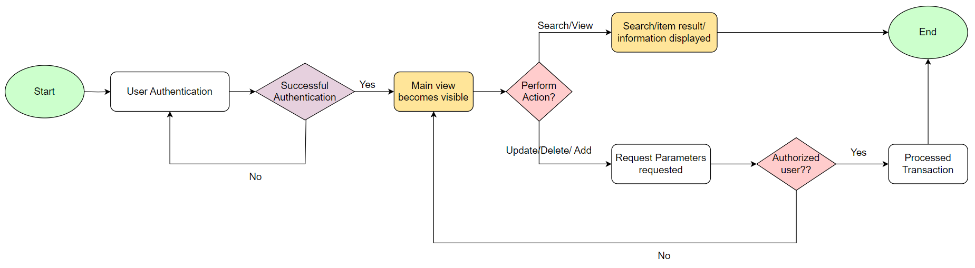
Serialized Asset Tracker - Process Map
Himaja Ghanashyam Dudhal

Slide 7
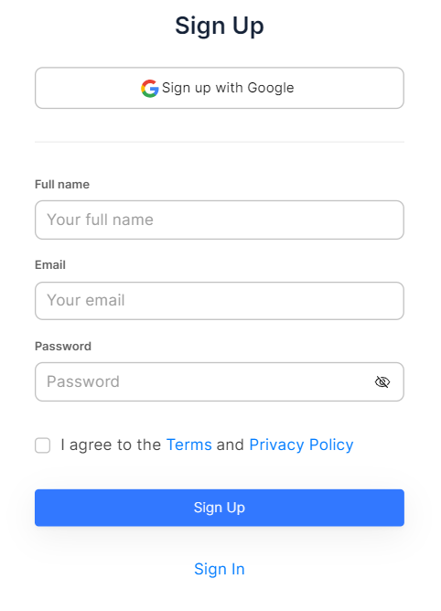
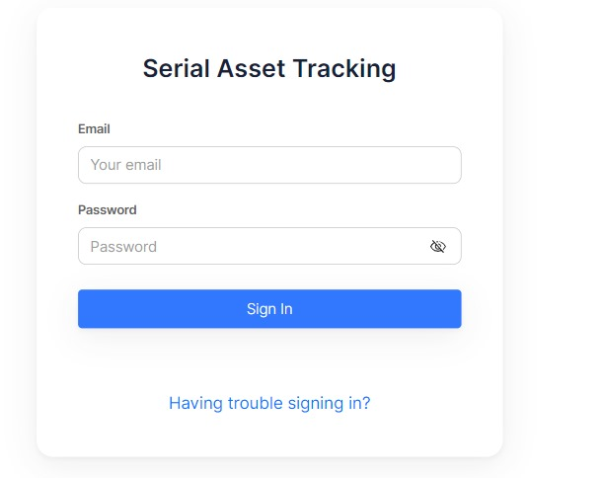
Serialized Asset Tracker - GUI
Himaja Ghanashyam Dudhal

Slide 8
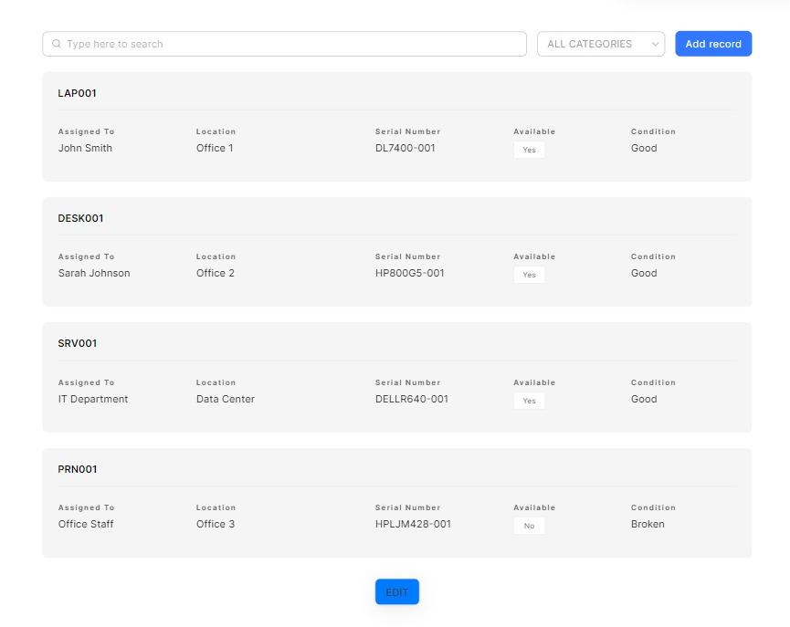

Serialized Asset Tracker - GUI
Himaja Ghanashyam Dudhal

Slide 9
Serialized Asset Tracker - Security Architecture
Login/Authentication
Clients start get to through the SAT login page.
Username and secret word are entered for verification.
SAT server confirms qualifications against its database.
Role-based get to control decides client authorizations.
Review path logs login endeavors for observing.
Himaja Ghanashyam Dudhal

Slide 10
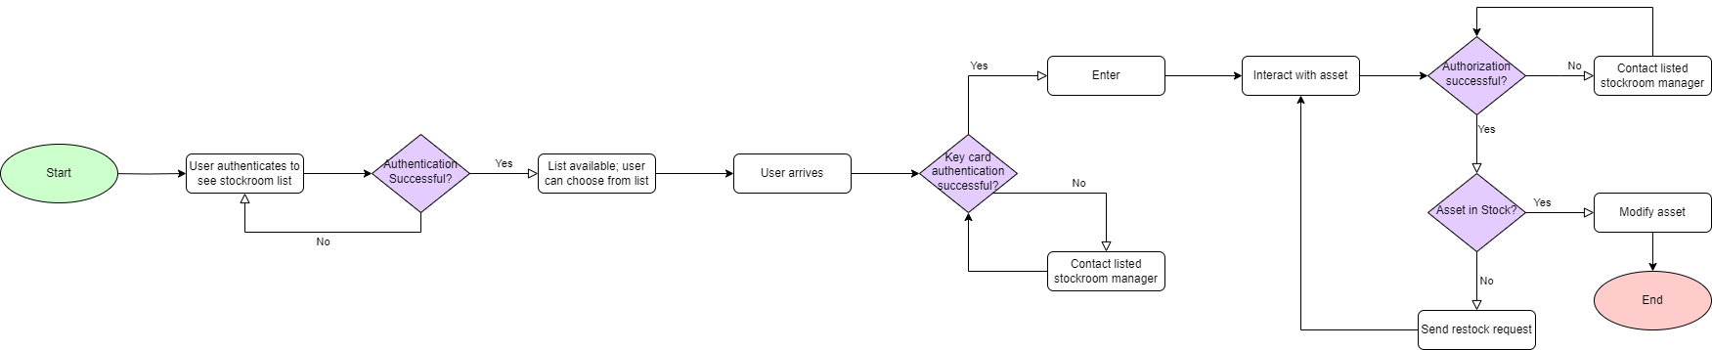
Stockroom - Process Map
Yasaswi Pandaraboyina

Slide 11
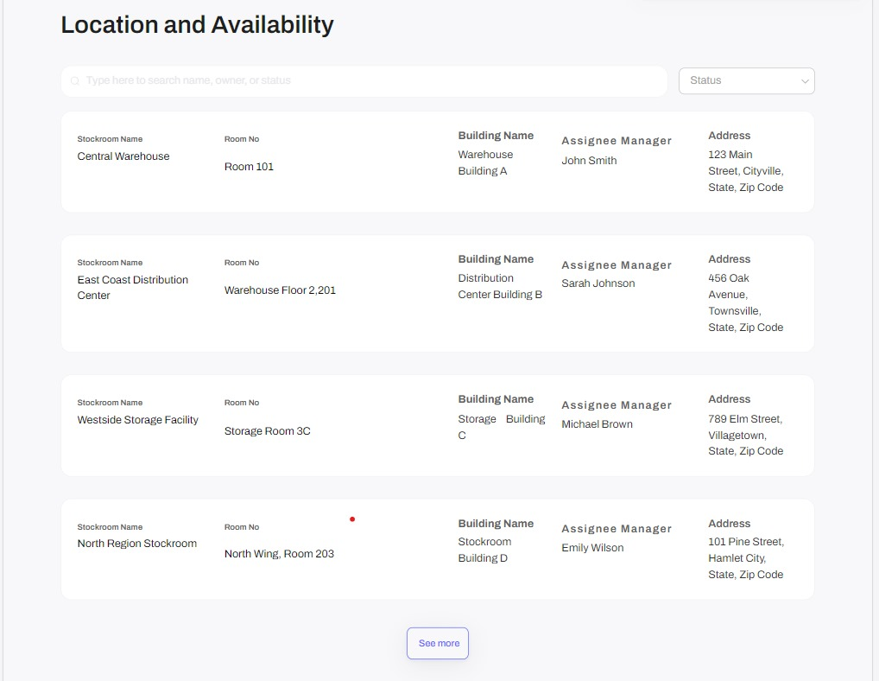
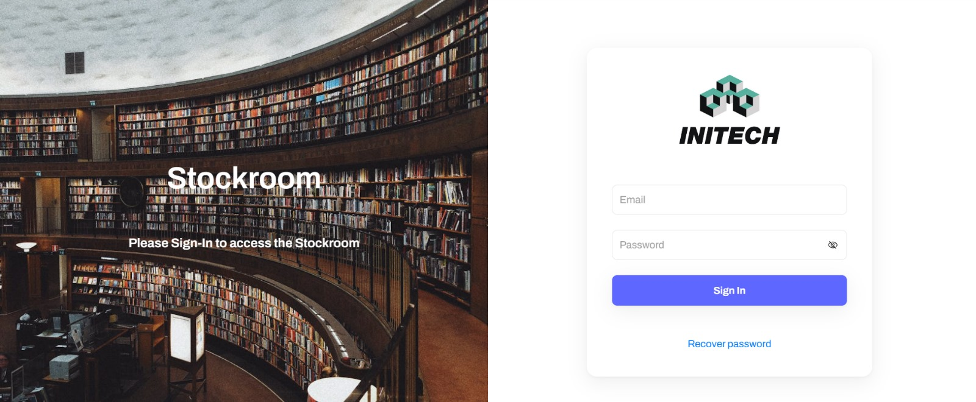
Stockroom - GUI
Yasaswi Pandaraboyina

Slide 12
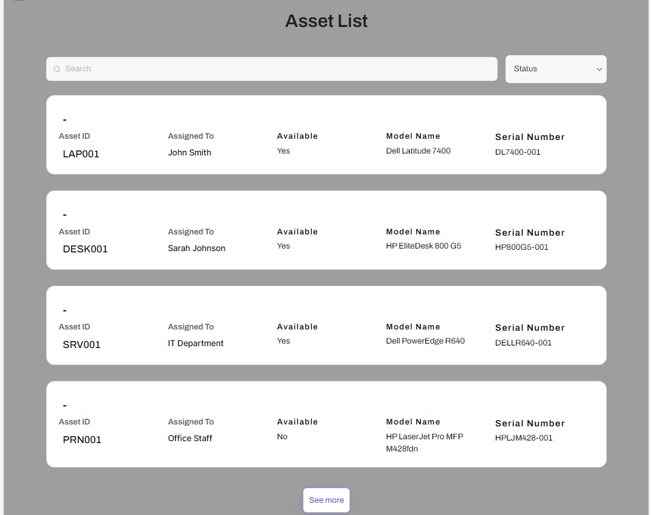
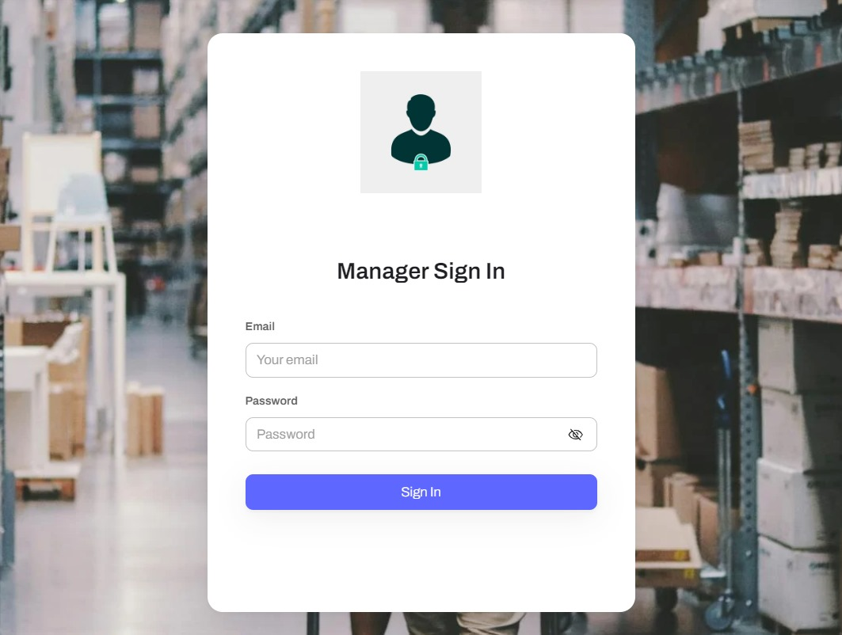
Stockroom - GUI
Yasaswi Pandaraboyina

Slide 13
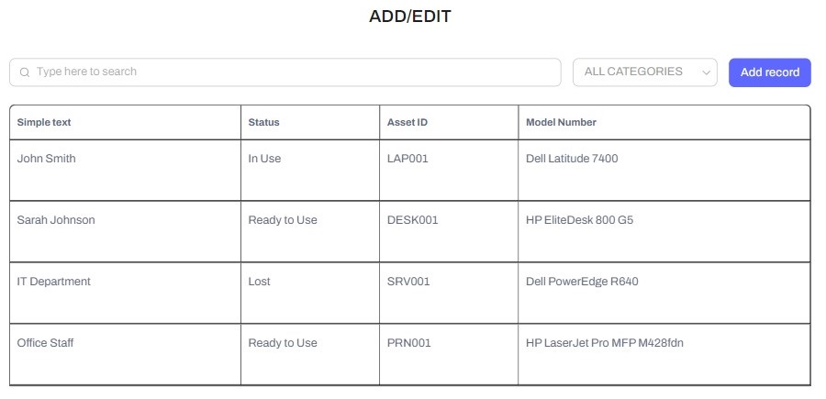
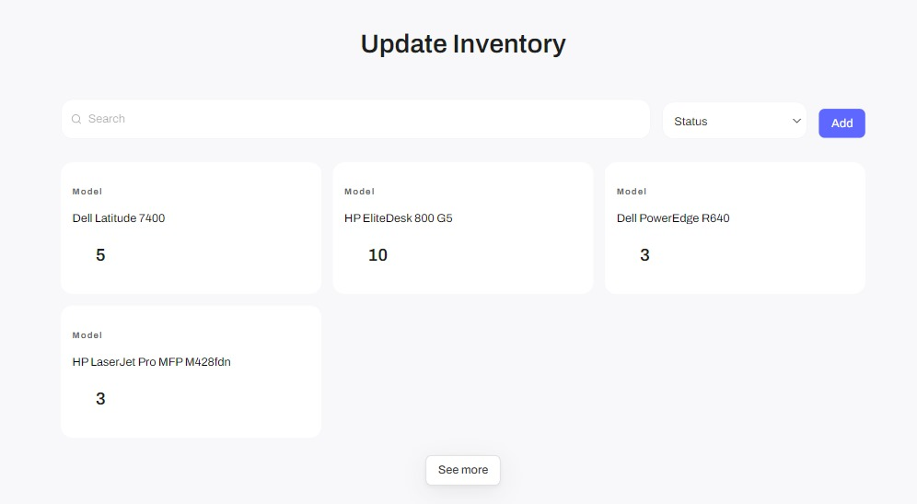
Yasaswi Pandaraboyina
Stockroom - GUI

Slide 14
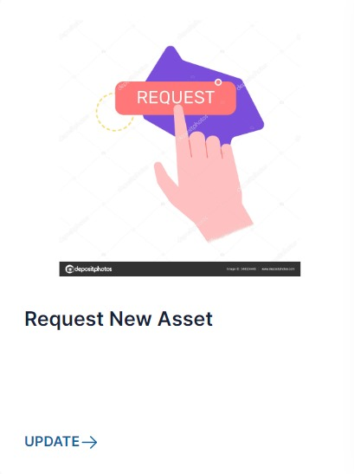

Stockroom - GUI
Yasaswi Pandaraboyina

Slide 15
Stockroom - Security Architecture
Login/Authentication
Get to begins at the Stockroom login page.
Clients give qualifications or utilize single sign-on (SSO).
Framework approves qualifications for realness.
Authorized clients pick up get to for resource intelligent.
Physical security measures like key card locks may be utilized.
Archana Kanchimireddy

Slide 16
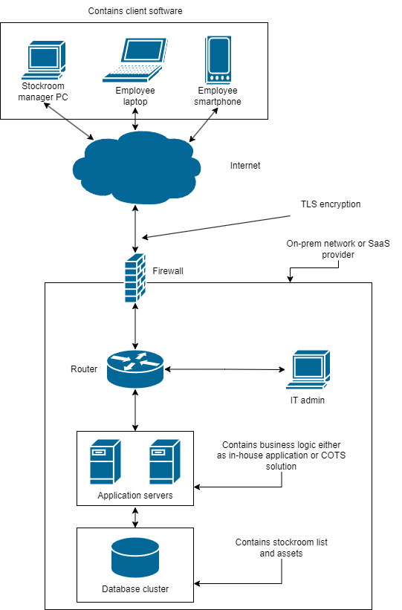
Network Topology
Archana Kanchimireddy

Slide 17
Integration With Process Maps
Login/authentication forms adjust with framework plan maps.
Client interfacing reflect secure get to components.
Wireframes portray login/authentication workflows.
Guarantees controlled get to to SAT and Stockroom functionalities.
Mitigates unauthorized get to and information breaches.
Archana Kanchimireddy

Slide 18
REFERENCES:
Express Metrix (2009). Quantifying ROI: Building the business case for IT and software asset management. https://www.expressmetrix.com/pdf/ROI_6.pdf
Tilley, S. (2020). Systems Analysis and Design (12th ed.). Cengage.
GoCodes. (n.d.). Feature list. Retrieved February 24, 2024, from https://gocodes.com/feature-list/
Service Now (n.d.). IT asset management. Retrieved February 24, 2024, from https://www.servicenow.com/products/it-asset-management.html

Slide 19
END

